Slide 1

GIT(Global Information Tracker )
GIT Stash
GIT Bisect
GIT Reflog
GIT Diff
GIT Cherry Pick
GIT Switch
GIT Rebase

Slide 2
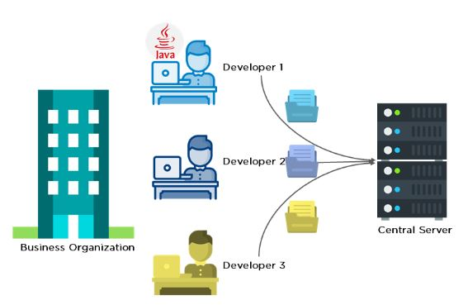
What is GIT , Why to use it ?
-> GIT is a an open source distributed version control system that is available for free.
-> Commonly used for software development and other collaborative projects.

Slide 3
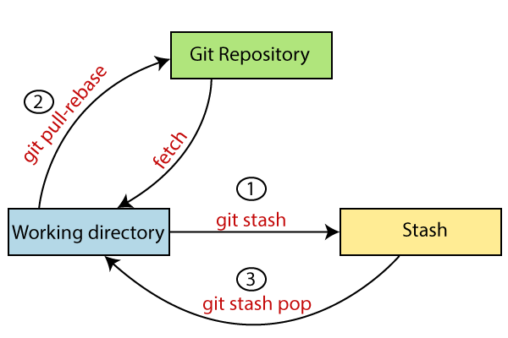
GIT STASH
-> It is a GIT command used to save the unfinished work.
->By using GIT stash we can terminate our ongoing work and switch to another work without completing the initial one the condition is the code cannot be commit or add.

Slide 4
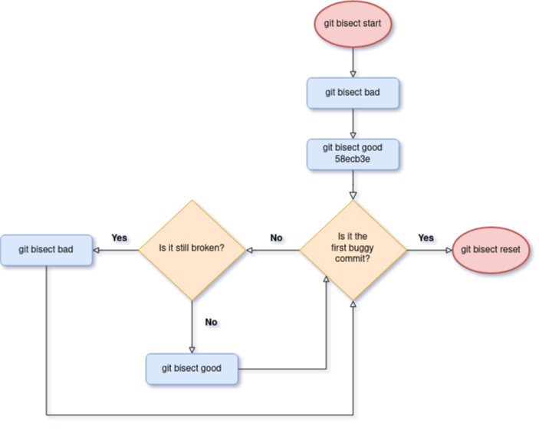
GIT BISECT
->It is a powerful command in GIT that helps you identify the specific commit that introduced a bug or regression in your codebase. It allows you to perform a binary search through the commit history to quickly locate the problematic commit.

Slide 5

GIT REFOLG
->It is a command in GIT that stand for “Reference Log” .
->It includes info about branch updates ,commit changes and other operations that modify the GIT history.
-> Useful for recovering lost commit or branches.
->These are just logs that GIT keeps for as a record.

Slide 6
Limitations of GIT Reflog
-> Local Repository only.
-> Limited history : To save disk space.
-> Not shared between clones.

Slide 7
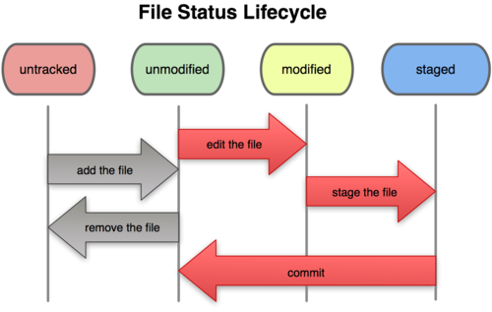

Slide 8
GIT DIFF
->GIT diff is a command that allows you to view the differences between different states of your codebase. It shows the changes made to files, lines, or even individual characters between two commits, branches, or other references in your GIT repository.
->The text in green represent the changes that we have added and the text in red represent the changes that we delete.

Slide 9
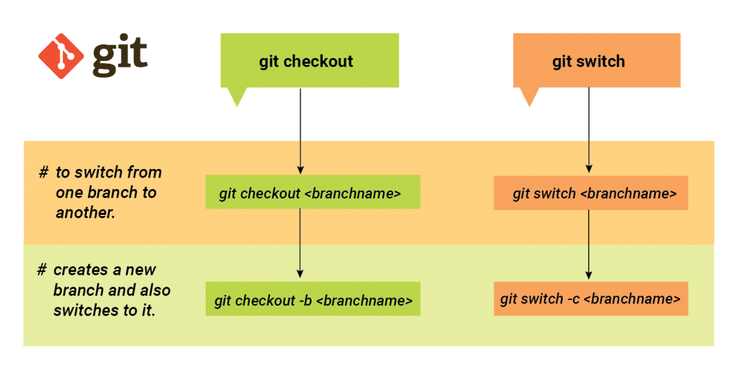
GIT Switch
->Allows us to switch between branches or restore your working directory to a specific commit or branch.
-> Example : GIT switch –c <branch-name>
Instead of 1st creating a branch and then switching it we can create and switch to the branch directly in one step by using above command .

Slide 10
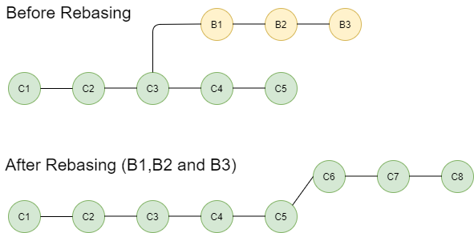
GIT REBASE
->This command used to integrate changes from one branch onto another .
-> It allows you to modify the commit history of a branch by moving, combining, or editing commits to create a more streamlined and linear history.

Slide 11
Here are the steps how GIT rebase works : 1. Select the target branch : specify the branch that you want to apply changes to 2. Start the rebase : This tells GIT to take the commits from the current branch and replay them on top of the specified branch. 3. Replay the commits : GIT goes through each commit on the current branch that is not already on the target branch. It removes these commits temporarily, one by one, and then applies them on top of the target branch. 4. Resolve conflicts : If there are any conflicts during the rebase process, GIT pauses and asks you to resolve them manually . 5. Finish the rebase : Once all the commits have been replayed and conflicts resolved, GIT completes the rebase. The current branch is now up to date with the changes from the target branch, and the commit history is modified accordingly.

Slide 12
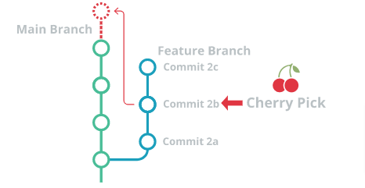
GIT CHERRY PICK
->GIT cherry pick allows you to select and apply a specific commit from one branch onto another branch.
->It lets you pick individual commits and apply them in isolation to another branch, independent of the commit history.

Slide 13
The GIT cherry pick command works as follows: 1.Identify the commit: You need to identify the commit that you want to cherry-pick. 2. Switch to the target branch: Move to the branch where you want to apply the cherry-picked commit. 3. Run cherry-pick: Execute the GIT cherry pick command followed by the commit hash you want to cherry-pick. For example: GIT cherry pick <commit hash> This command creates a new commit on the current branch, incorporating the changes from the cherry-picked commit. 4. Resolve conflicts: If there are any conflicts between the cherry-picked commit and the target branch, Git will pause the cherry-pick process and prompt you to resolve the conflicts manually. 5. Finish cherry-pick: Once the conflicts, if any, have been resolved, Git completes the cherry-pick by creating a new commit on the target branch that replicates the changes from the cherry-picked commit.

Slide 14

GIT cherry-pick is useful when you want to selectively apply specific commits from one branch to another, rather than merging or rebasing entire branches. It allows you to pick individual change sets and apply them to different branches, making it a flexible tool for managing your GIT workflow.

